Slide 1

Infectious disease modelling course
Jointly organised by LSHTM, Fudan University and HKU under the auspices of NIHR EPIC, 12-14 August 2019
Introduction to Infectious Disease Modeling
Joseph Wu (joewu@hku.hk)

Slide 2
Learning outcome
To demonstrate the basic epidemiologic and modeling knowledge needed for building simple epidemic models

Slide 3








What are models?
Our understanding of how things work in the real world We use models to make decisions everyday (often without being aware of it)

Slide 4
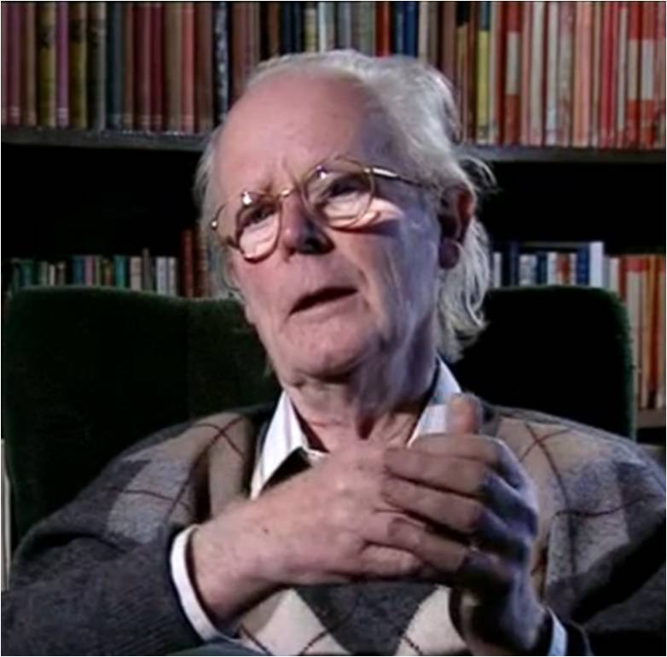
The purpose of models
For understanding and predicting the behaviors of systems that we are interested in.
Models are approximations or simplifications of real-world systems
“Describing complex, poorly-understood reality with a complex poorly-understood model is not progress.”
John Maynard Smith FRS Evolutionary biologist and geneticist

Slide 5

Examples from everyday life

Slide 6
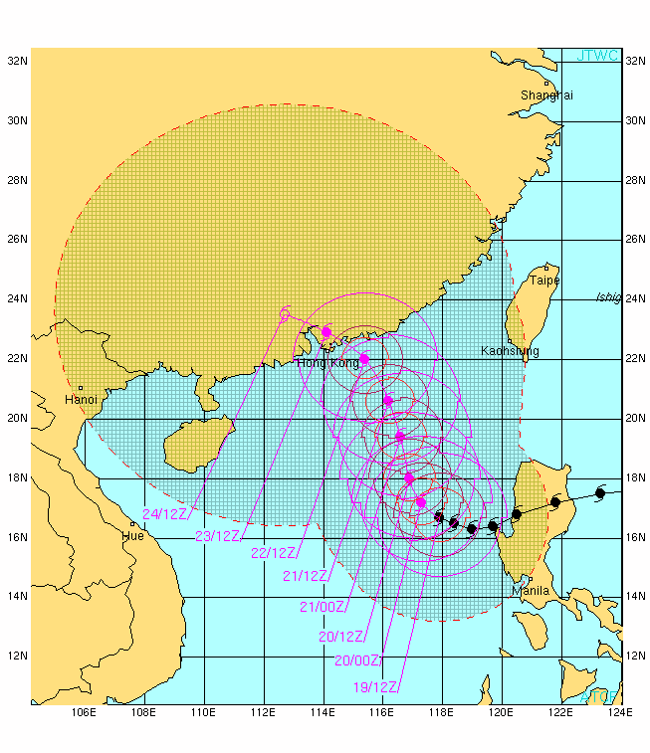
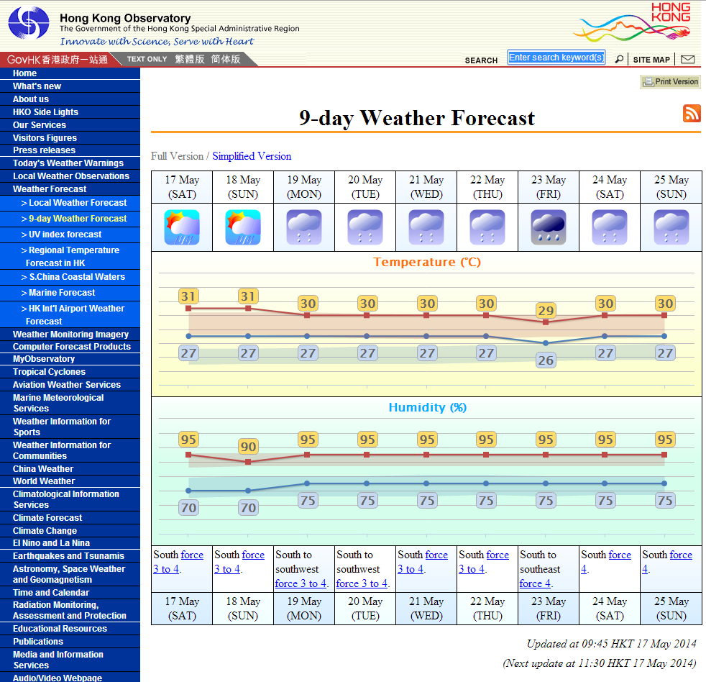
Examples from everyday life

Slide 7
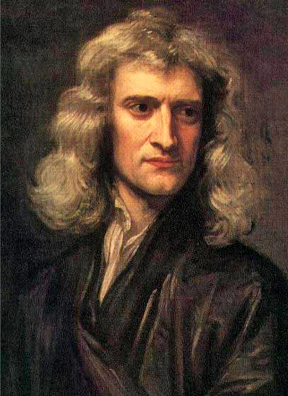
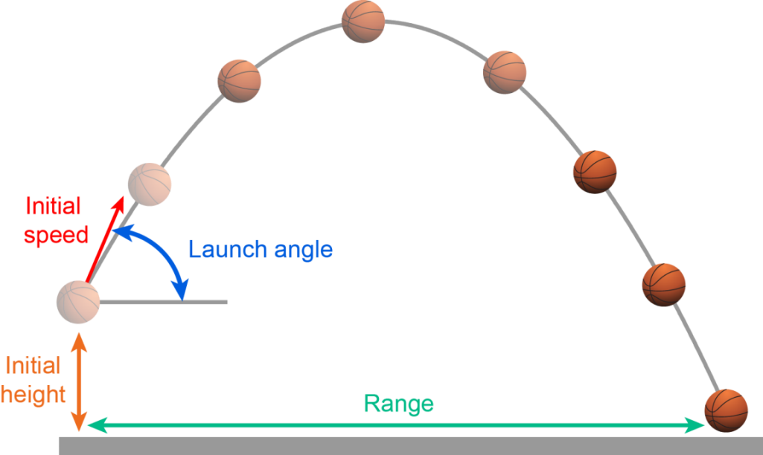
Mathematical models
A bottom-up approach to integrate assumptions about the underlying processes and empirical data from the real world to describe the behavior of the system
Explanations and prediction of
the behavior of the system
MODEL
Data
Assumptions
Sir Isaac Newton

Slide 8
Infectious disease modeling
A systematic way of translating assumptions and data regarding disease transmission into quantitative description of how an epidemic evolves.
Just like animal models, infectious disease modeling is a tool for helping you collect your thoughts about a complex problem to generate and test hypotheses.
Some uses of infectious disease modeling:
Estimating transmission parameters from epidemiologic data
Estimating effectiveness of interventions from epidemiologic data, e.g. vaccination or school closure
Predicting the cost and effectiveness of intervention strategies, e.g. vaccinating core transmission group vs high-risk group

Slide 9
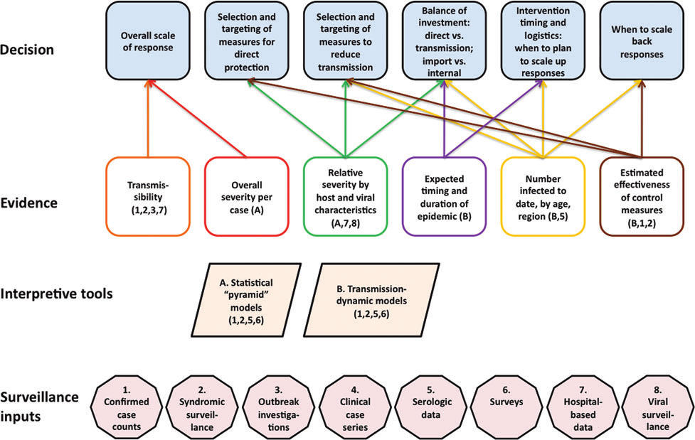
Infectious disease modeling: From data to decisions
Lipsitch et al Biosecur Bioterror 2011

Slide 10
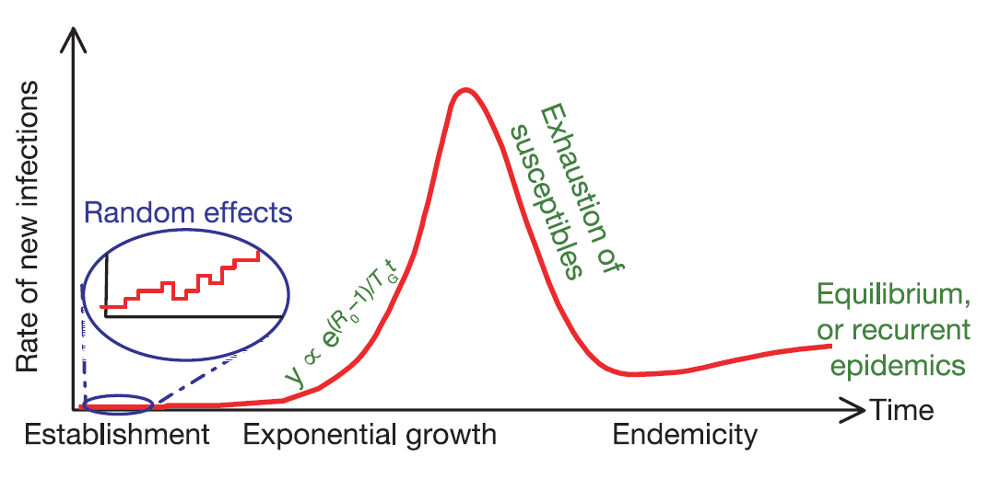
Anatomy of an epidemic
1. Random effects (e.g. probability of extinction) are substantial when the number of infections is small
3. Epidemic peaks when the susceptible pool has been sufficiently depleted such that reproductive number is 1
2. No. of new infections grow exponentially after the epidemic has taken off
4. Sustained disease transmission after the epidemic depends on replenishment of the susceptible pool
Ferguson et al Nature 2003

Slide 11
Basic epidemiologic concepts
Three epidemiologic parameters form the cornerstones of mathematical epidemiology:
Basic reproductive number, R₀
The average number of secondary cases generated by an index case when an epidemic begins in a completely susceptible population .
Mean generation time, T_{g}
The average time it takes an index case to infect other individuals after he becomes infected.
Epidemic growth rate, r
The rate at which the number of infections is increasing
During the early phase, the epidemic doubling time is t_{d} = ln2/r. Why? During this phase, the epidemic size is growing exponentially at rate r. This means
2 × current size = current size × exp(rt_{d})

Slide 12
Basic reproductive number, R₀
The average number of secondary cases generated by an index case in a fully susceptible population:
Reproductive number, R: Same as R₀ except that the population needs not be completely susceptible
Some time after the epidemic has started, in which case we denote the reproductive number by R_{t}.
If the population is partially vaccinated before the outbreak.
B
A
C
1st generation
2nd generation
3rd generation

Slide 13
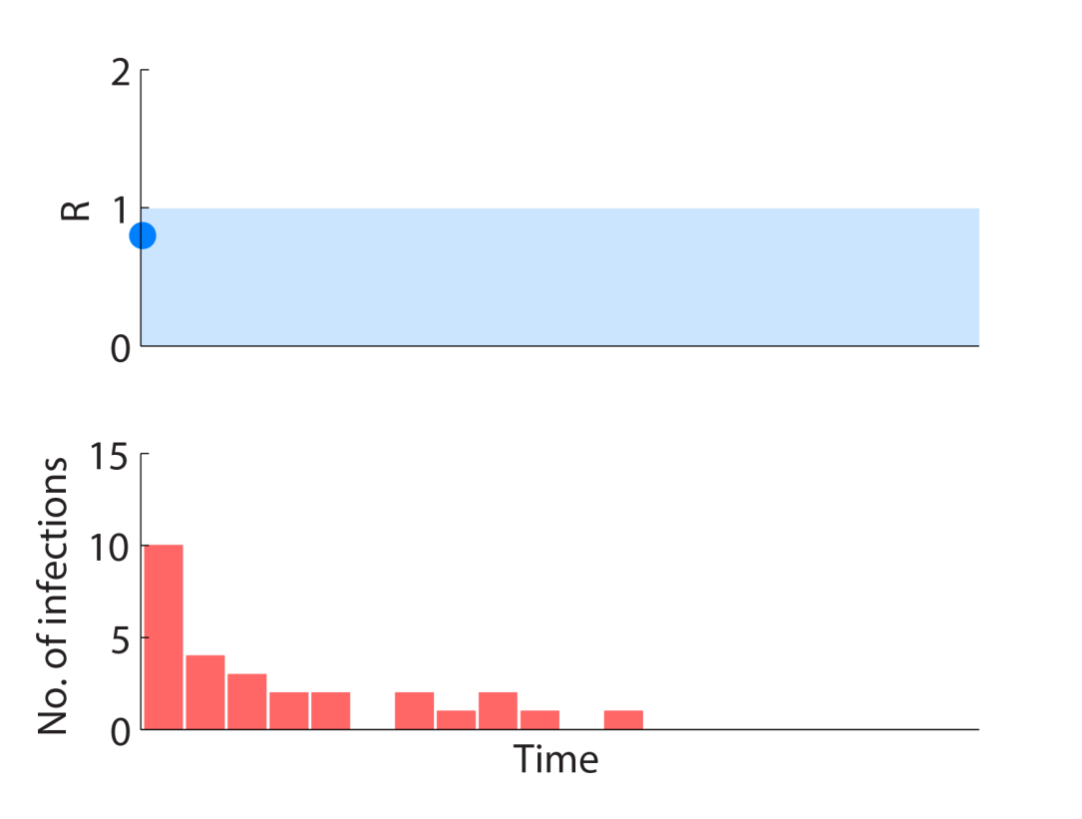
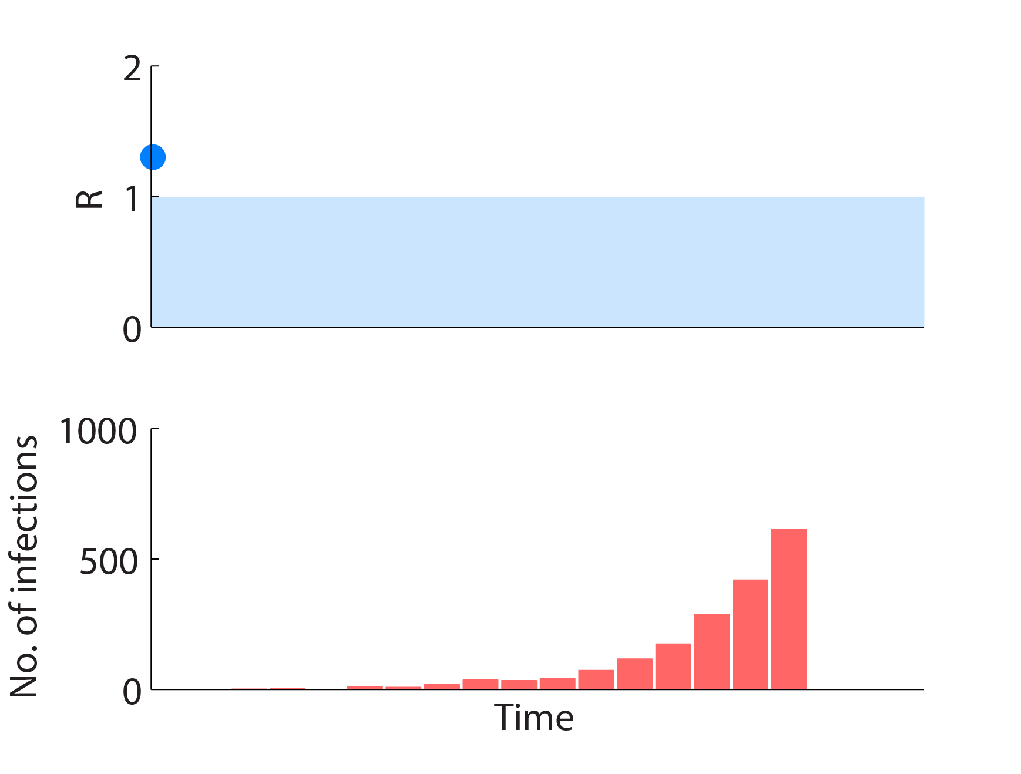
Basic reproductive number, R₀
The average number of secondary cases generated by an index case in a fully susceptible population.
R₀ < 1: The epidemic will die out without exponential growth
R₀ > 1: The pathogen can lead to an exponentially growing epidemic
Exponential growth
10 infected
seeds
The epidemic dies out
without exponential growth
10 infected
seeds
How to estimate R₀?
Contract tracing and cohort follow-up.
Fitting mathematical models to epidemic curves.

Slide 14
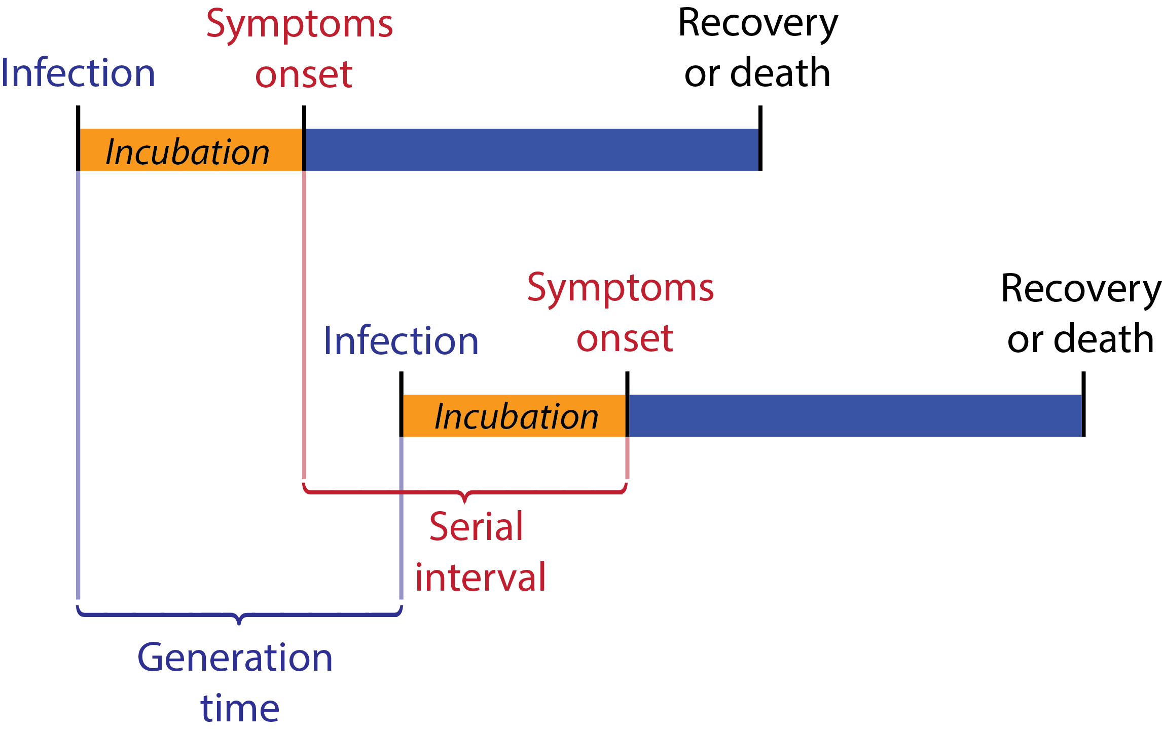


Timescale of disease transmission
Reproductive number describes the number of secondary cases but not how long it takes for infections to occur.
Generation time: Time between successive infections.
Serial interval: Time between symptom onset of successive infections.

Slide 15

Shorter generation time or serial interval means that confirmed and probable cases would need to be identified and removed from the population sooner in order to prevent them from spreading the disease.
Timescale of disease transmission
SARS
Serial interval = 8 days
2nd infectee 3rd infectee
1st infectee
Infections are prevented if isolated
during this period
Time since infection
Influenza
Serial interval = 3 days
2nd infectee 3rd infectee
1stinfectee
Infections are prevented if isolated during this period
Time since infection

Slide 16
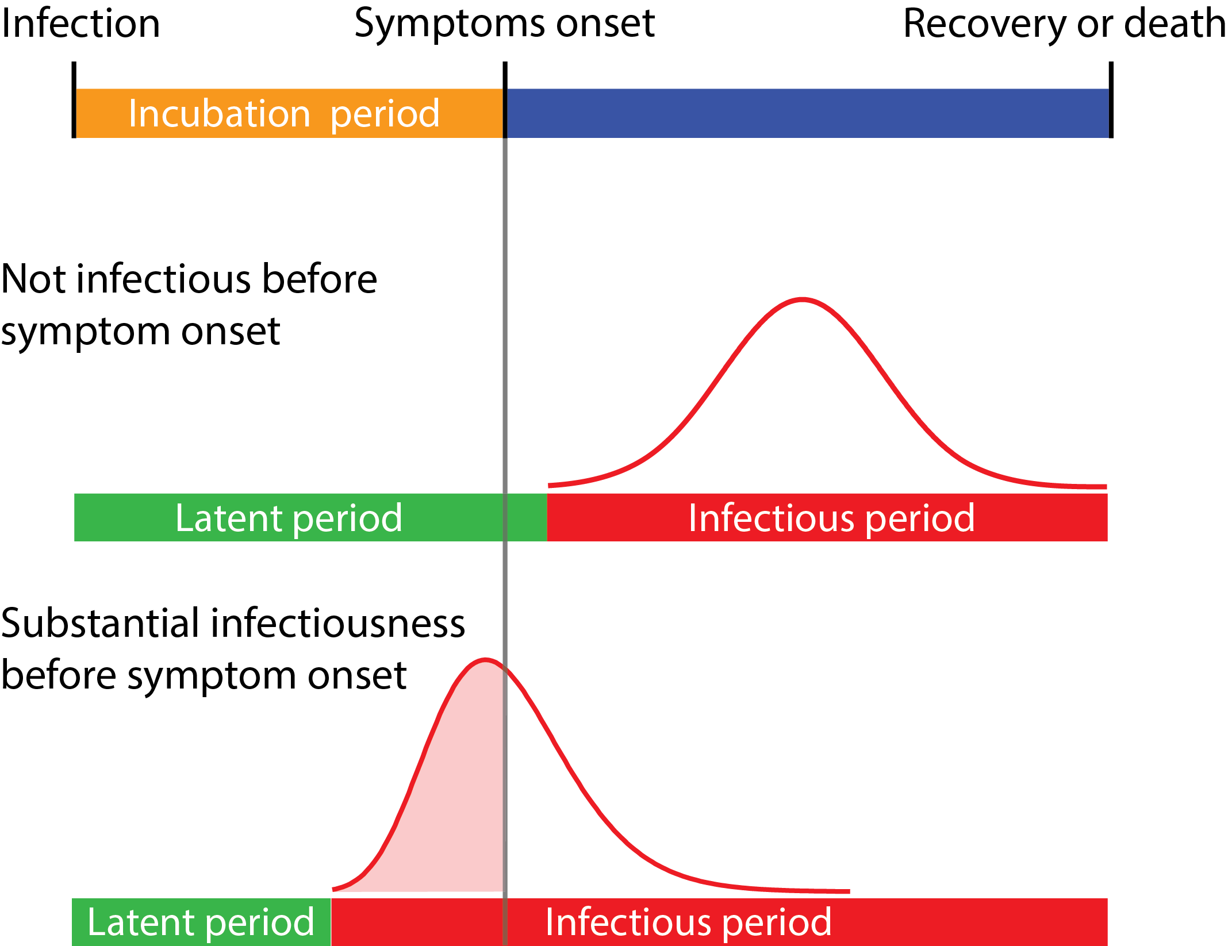
Timescale of disease transmission
Latent period
The time it takes to become infectious after infection.
Can be longer or shorter than incubation period.
Isolation upon symptoms onset is VERY effective for preventing transmission
e.g. SARS
Isolation upon symptoms onset is NOT effective for preventing transmission
e.g. Influenza

Slide 17
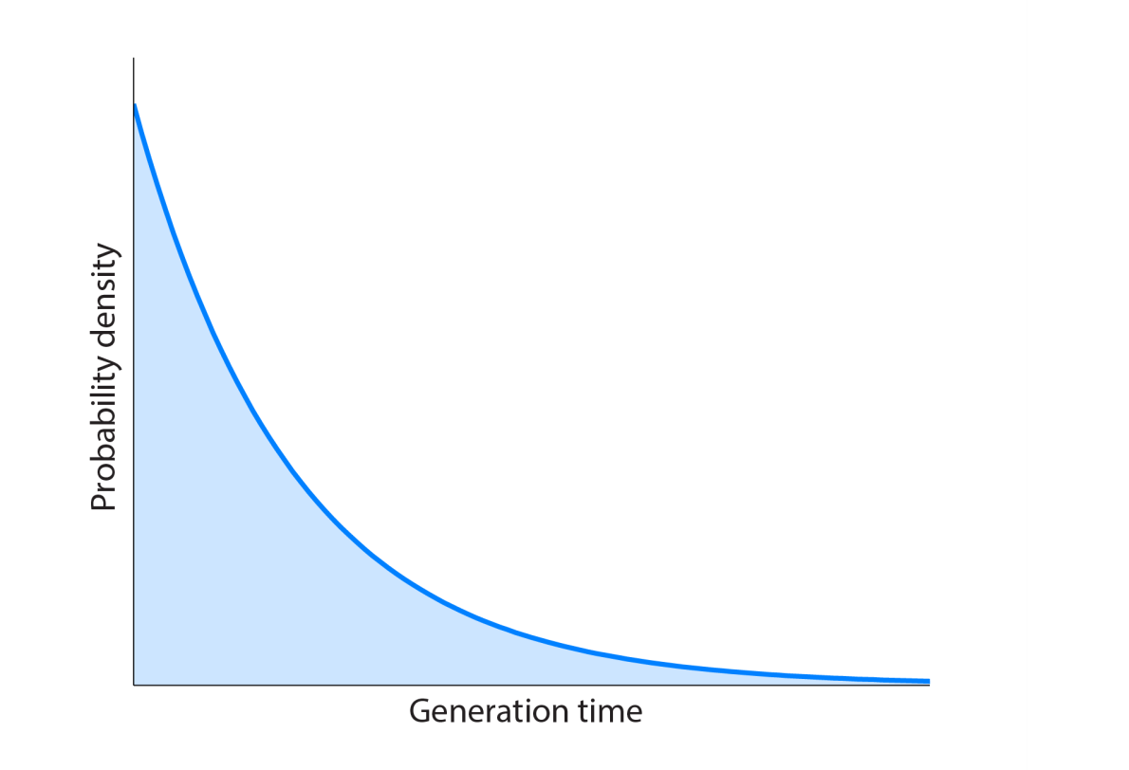
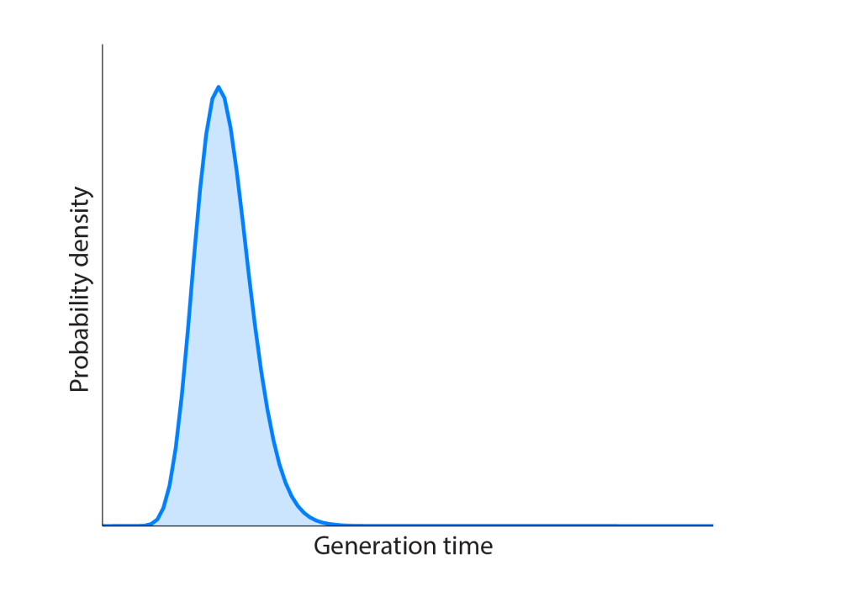
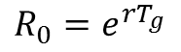
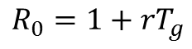
Epidemic growth rate depends on R₀ and T_{g}
Mean generation time T_{g}: the average time it takes an index case to infect other individuals after he becomes infected.
R₀, T_{g} and epidemic growth rate r are interrelated. For a given R₀, a shorter T_{g} means a higher growth rate.
t₁
t₂
T_{g} = the average of t₁, t₂, t₃, t₄
t₃
t₄
$$R_{0}=1+rT_{g}$$
$$R_{0}=e^{rT_{g} }$$

Slide 18
Herd immunity
Immunity of an individual not only protects the individual himself from infection, but also reduces the risk of infection for everyone in the population.
Susceptible
Infected
Vaccinated(100% directly protected)
I

Slide 19
Herd immunity
Immunity of an individual not only protects the individual himself from infection, but also reduces the risk of infection for everyone in the population.
Susceptible
Infected
Vaccinated(100% directly protected)
I

Slide 20
Herd immunity
Immunity of an individual not only protects the individual himself from infection, but also reduces the risk of infection for everyone in the population.
Susceptible
Infected
Vaccinated(100% directly protected)
I
I

Slide 21
Herd immunity
Immunity of an individual not only protects the individual himself from infection, but also reduces the risk of infection for everyone in the population.
Susceptible
Infected
Vaccinated(100% directly protected)
I
I

Slide 22
Herd immunity
Immunity of an individual not only protects the individual himself from infection, but also reduces the risk of infection for everyone in the population.
Susceptible
Infected
Vaccinated(100% directly protected)
I
I

Slide 23
Herd immunity
Immunity of an individual not only protects the individual himself from infection, but also reduces the risk of infection for everyone in the population.
Susceptible
Infected
Vaccinated(100% directly protected)
Indirectly protected
I
I

Slide 24
Vaccination
Suppose the vaccine is 100% efficacious.
It is not necessary to vaccinate the whole population to halt a growing epidemic. Why?
Vaccinating an individual indirectly reduces the risk of infection of this individual’s contacts (herd immunity).
Infected Susceptible Vaccinated
Vaccination with coverage p
R = R₀ R = R₀(1−p)

Slide 25
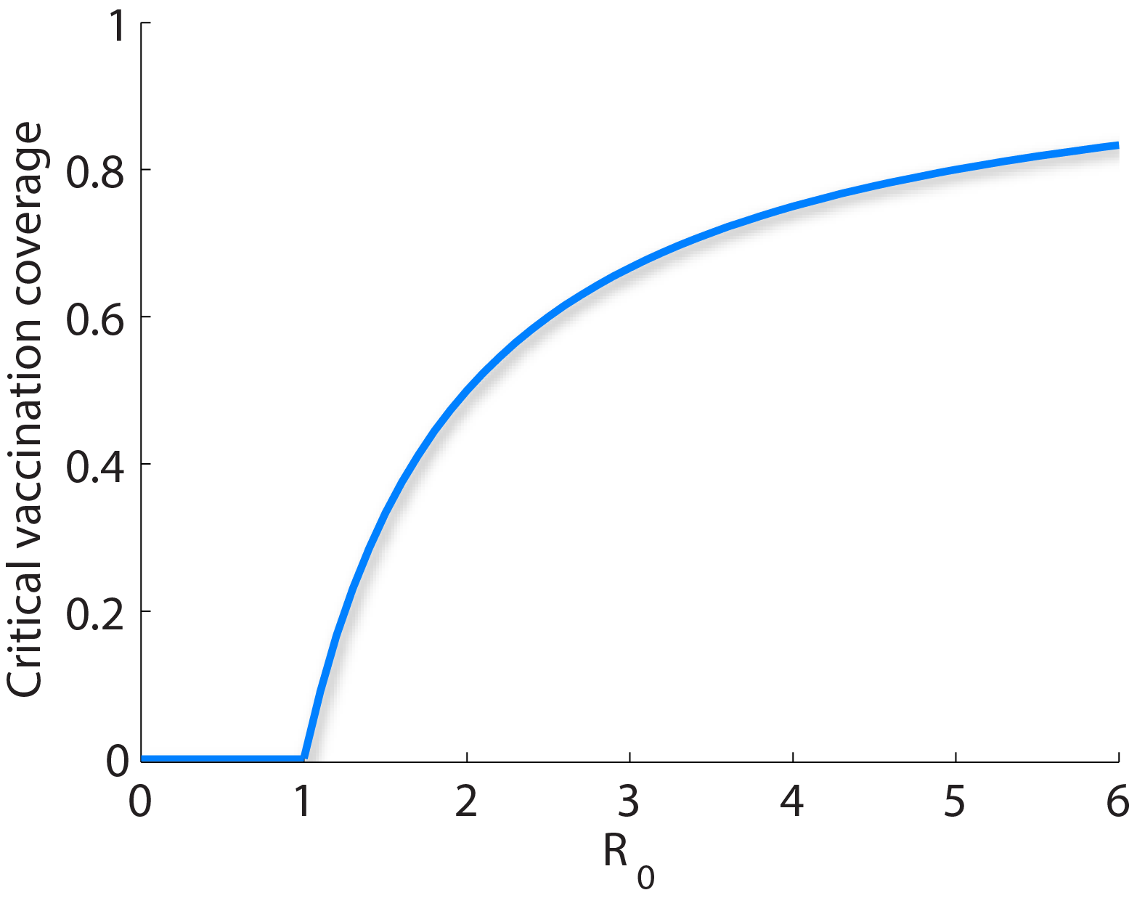
Vaccination
Suppose the vaccine is 100% efficacious.
Critical vaccination coverage, c*
The minimal proportion needed to be vaccinated in order to prevent an epidemic.
In the SIR model, c* = 1–1/R₀, i.e. vaccinating a proportion p > 1–1/R₀ of the population is sufficient to prevent an epidemic. Why?
After vaccination, the
reproductive number is
eradication
persistence

Slide 26
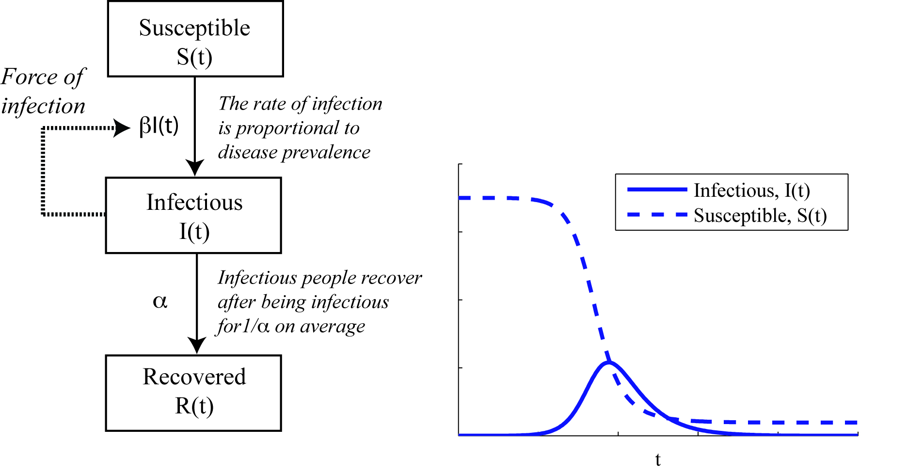
The simplest epidemic model
A closed population of size N is partitioned into three compartments of individuals: “Susceptible”, “Infectious”, and “Recovered” (SIR model).
All individuals are assumed to be identical in terms of their (i) susceptibility to infection, (ii) infectiousness if infected, and (iii) mixing behavior associated with disease transmission (the so-called homogenous mixing assumption).
Hallmarks of an epidemic:
The number of infections increases exponentially during the early phase of a growing epidemic
The epidemic curve is unimodal and peaks when the susceptible pool has been sufficiently depleted (such that R_{t} < 1)
2
Epidemiologic parameters:
R₀ = β/α, T_{g} = 1/α
r = (R₀−1)/T_{g} = β − α
1

Slide 27
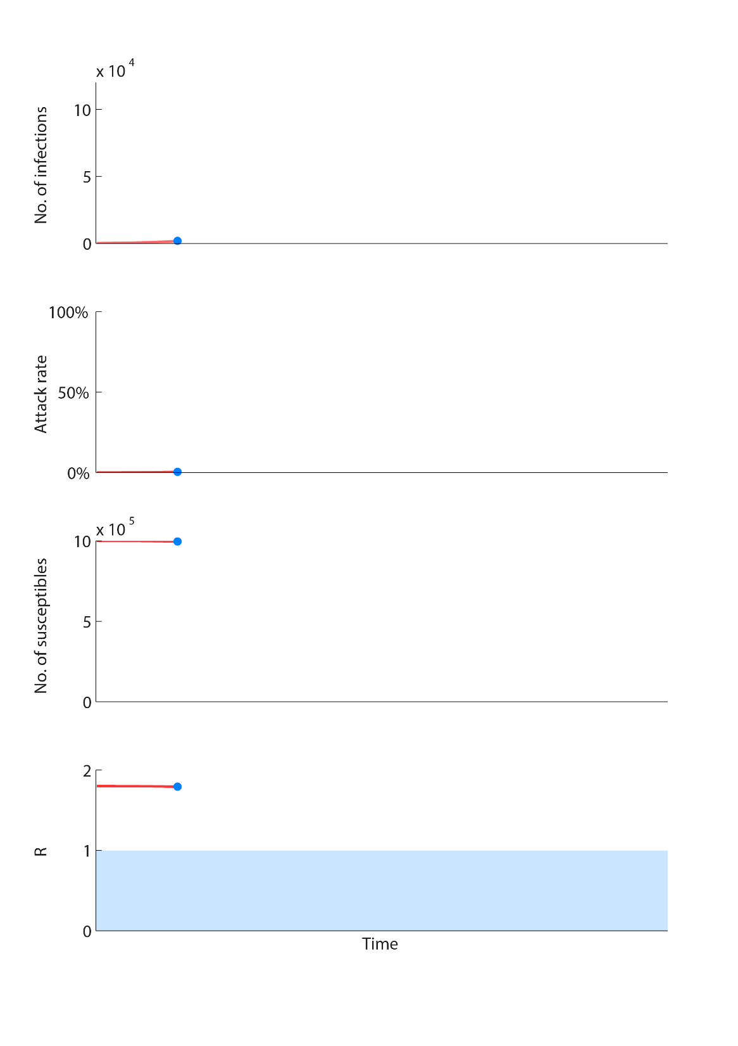
SIR epidemic dynamics

Slide 28
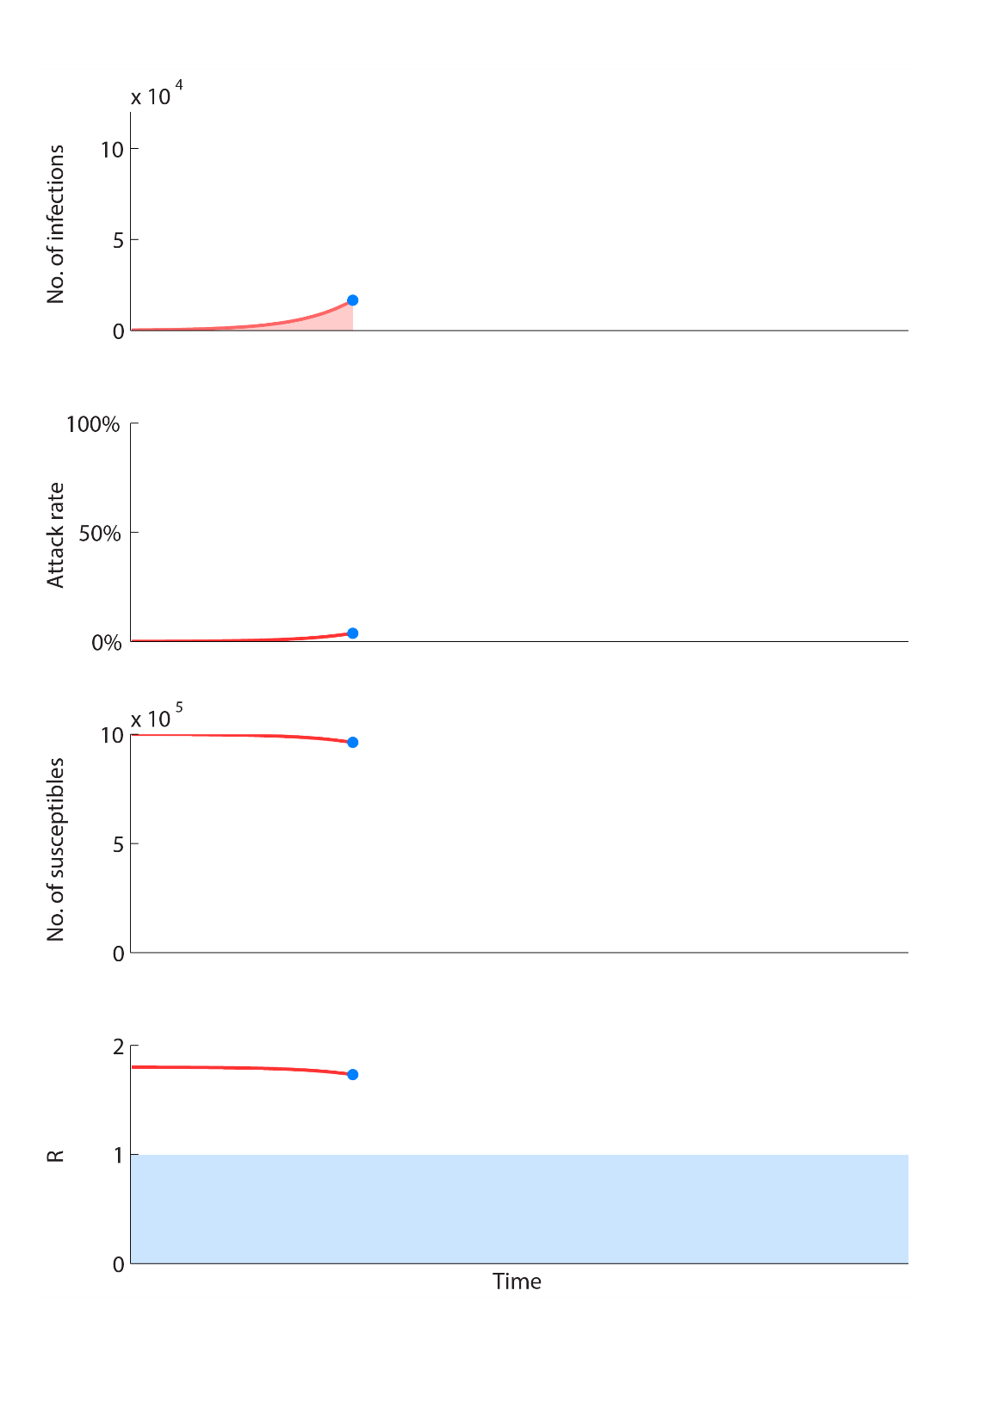
SIR epidemic dynamics
Exponential
growth

Slide 29
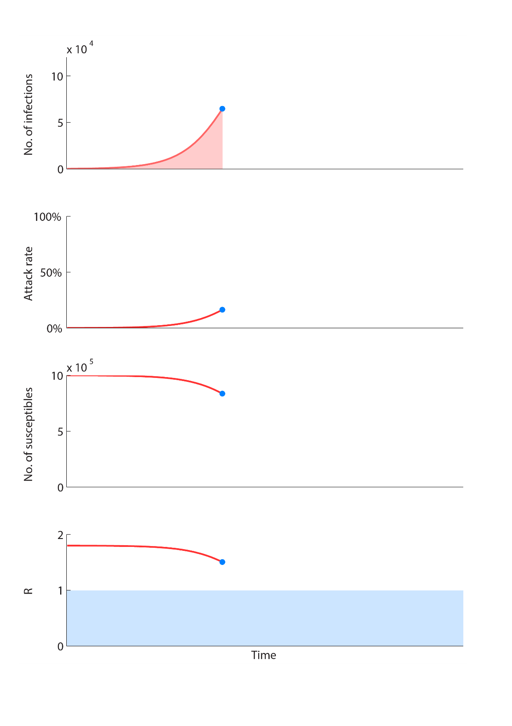
SIR epidemic dynamics
Exponential
growth
Attack rate increases
Depletion of susceptibles
R decreases

Slide 30
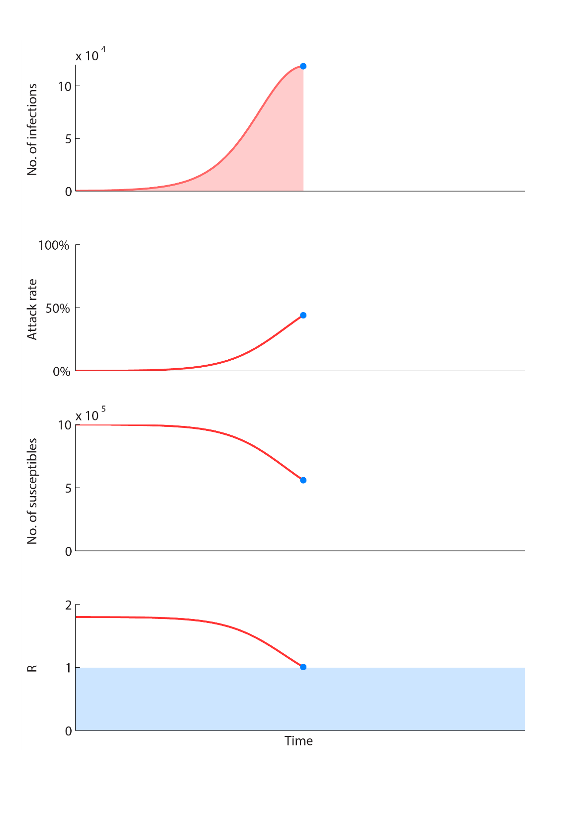
SIR epidemic dynamics
The epidemic peaks
Attack rate increases
Depletion of susceptibles
R drops to 1

Slide 31
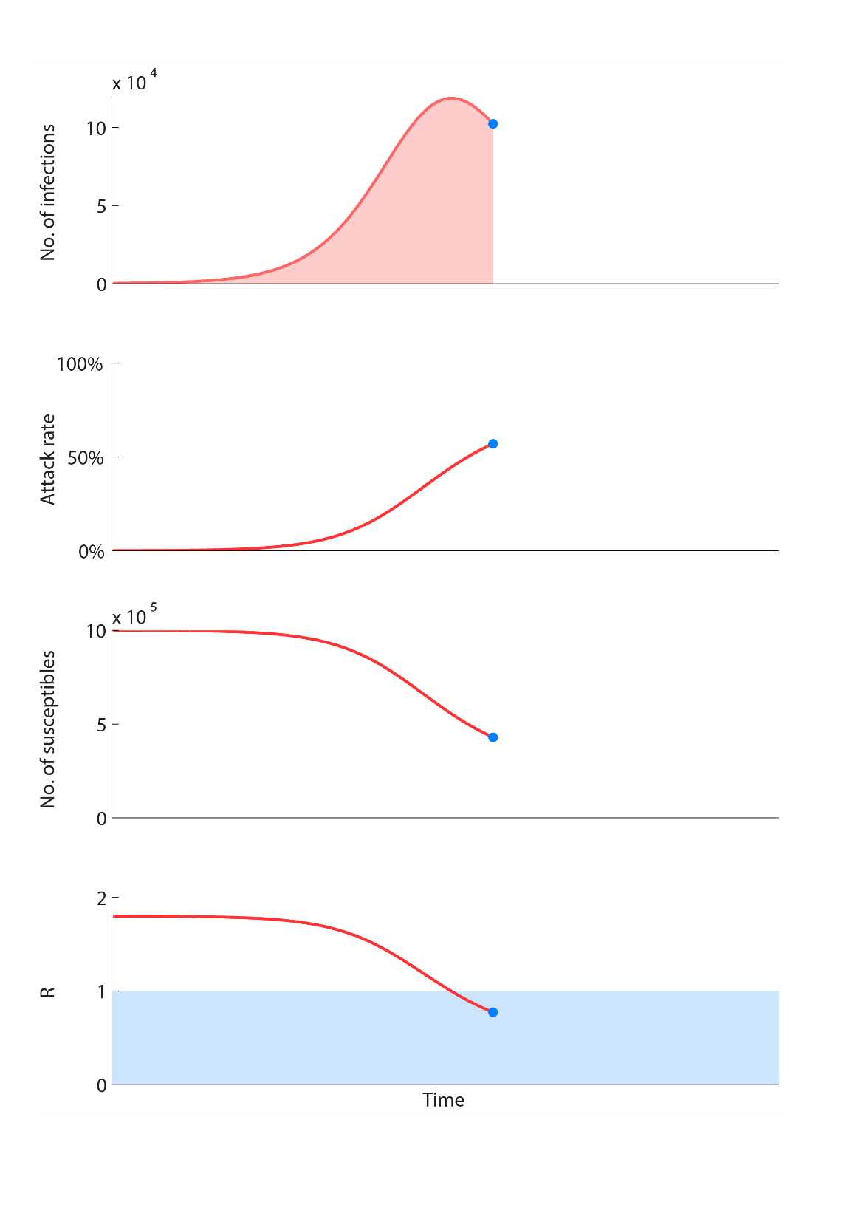
SIR epidemic dynamics
Incidence begins to drop
Attack rate increases
Depletion of susceptibles
R drops below 1

Slide 32
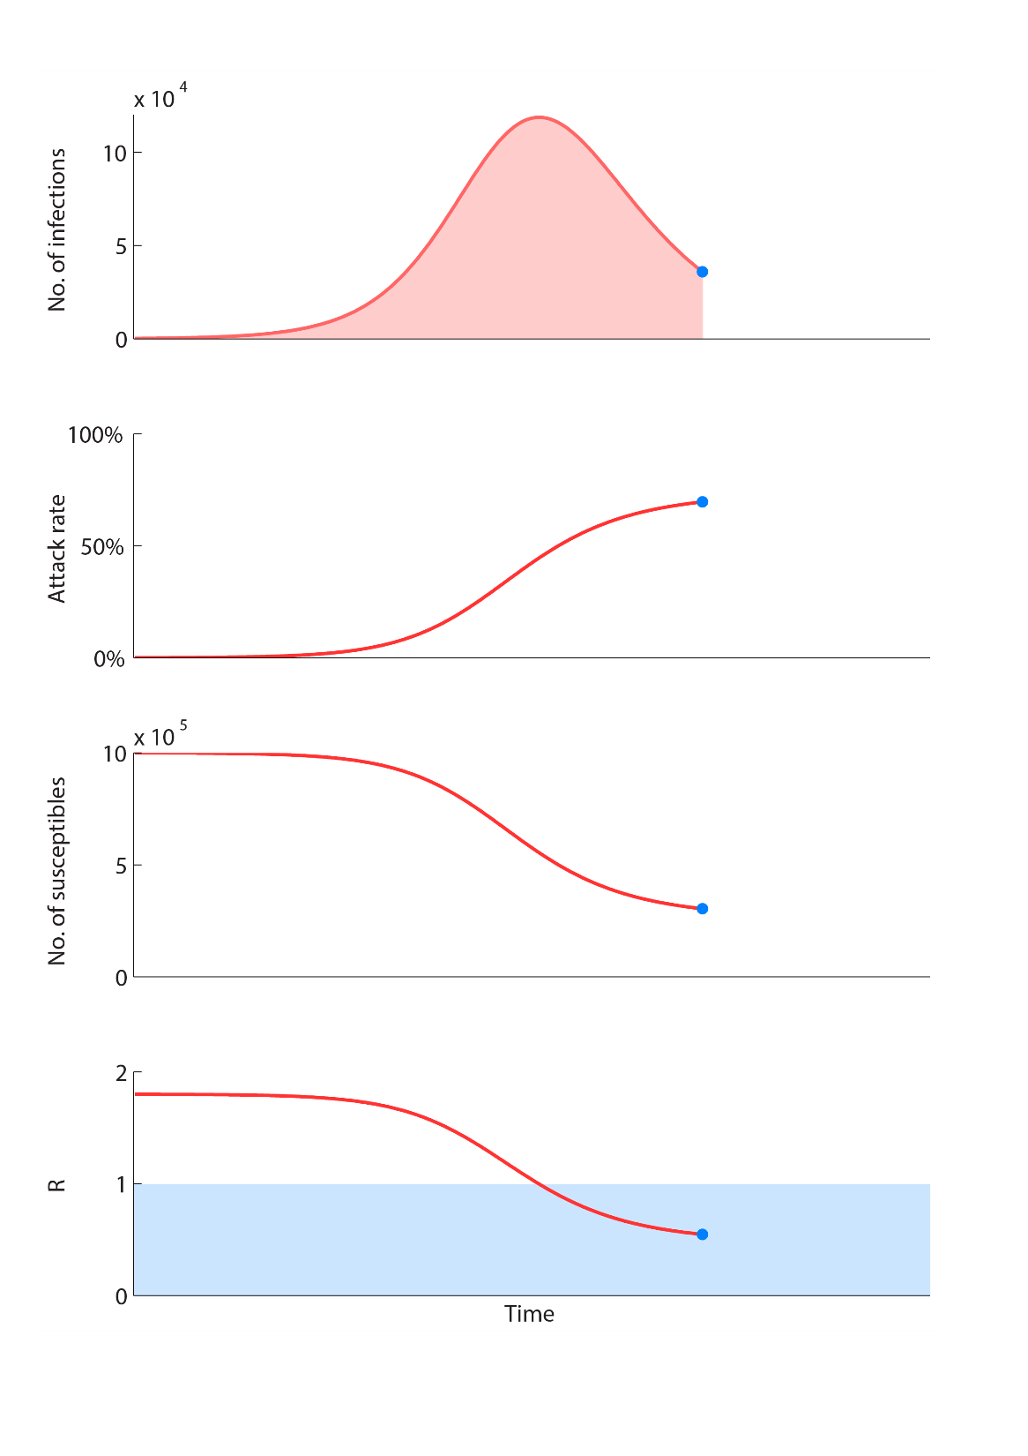
SIR epidemic dynamics
Incidence drops
monotonically
Attack rate increases
Depletion of susceptibles
R drops below 1

Slide 33
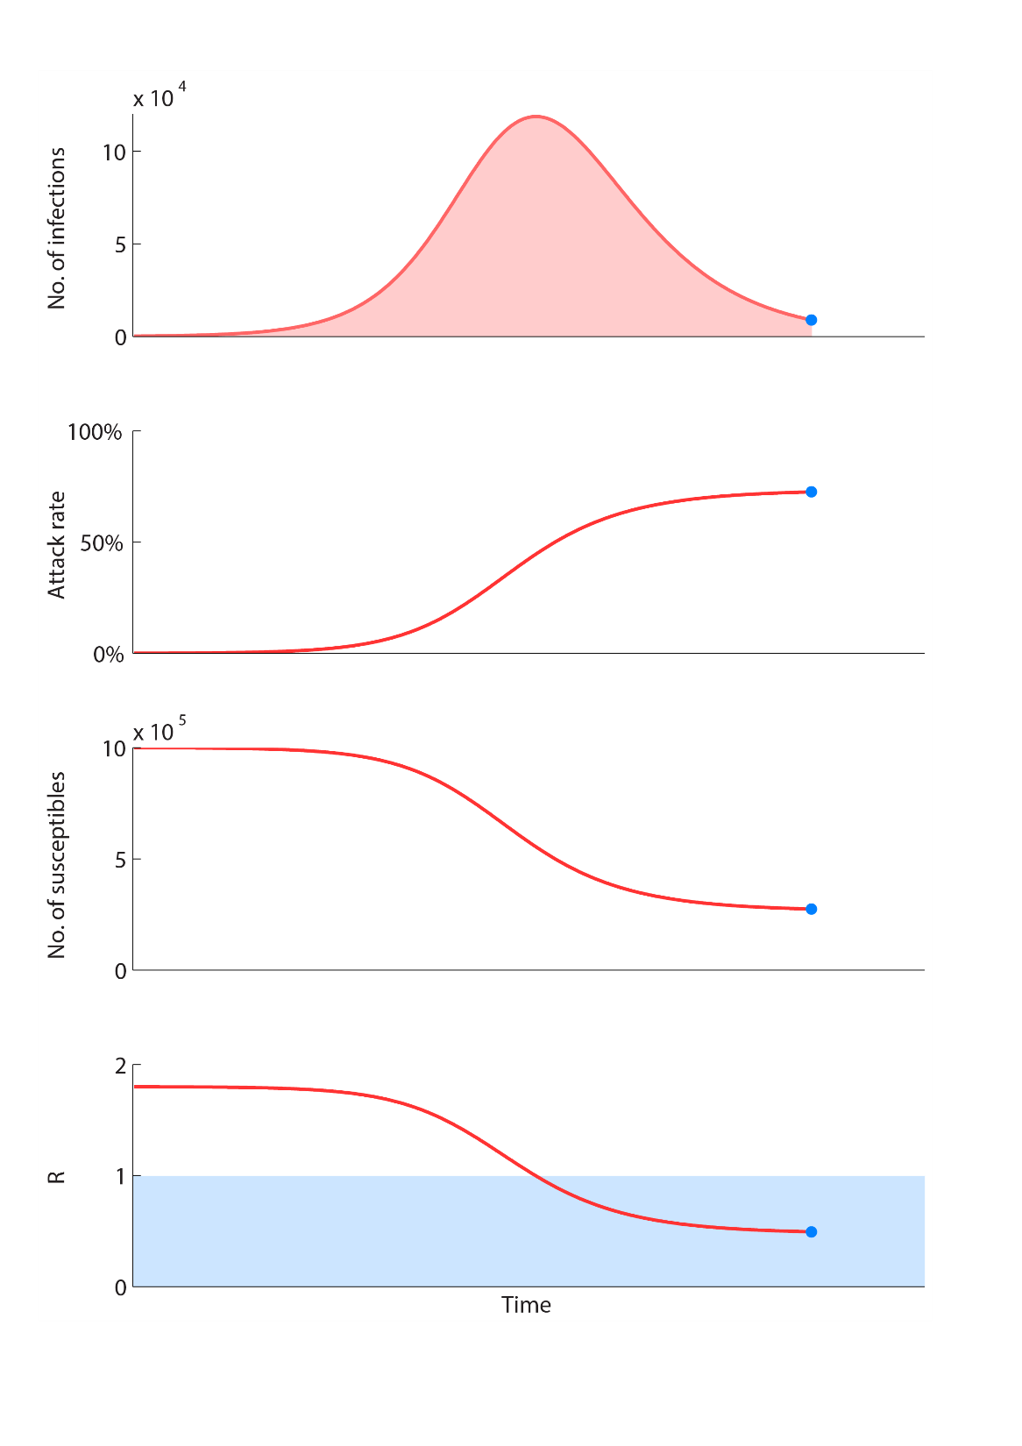
SIR epidemic dynamics
The epidemic
dies out
Attack rate increases
Depletion of susceptibles
R drops below 1

Slide 34
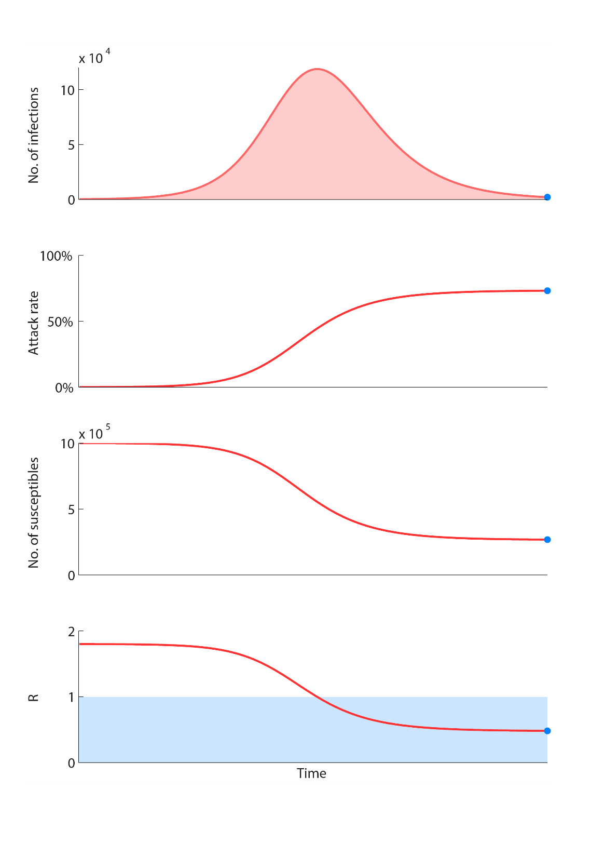
SIR epidemic dynamics
The epidemic
dies out
Final attack rate
Depletion of susceptibles
R drops below 1

Slide 35
SIR epidemic dynamics
The epidemic
dies out
Final attack rate < 100%
Depletion of susceptibles
R drops below 1

Slide 36
Model equations and flow diagrams
Differential equations
Flow diagrams
Boxes: compartments or states
Arrows: rates = 1 / (mean duration in the origin state)
The number of individuals going from origin state to destination state between time t and t+Δt is
(number of individuals in the origin state at time t) × rate × Δt
[S(t+Δt)− S(t)]/Δt = dS/dt as Δt → 0
S
I
R
βI(t)
α

Slide 37
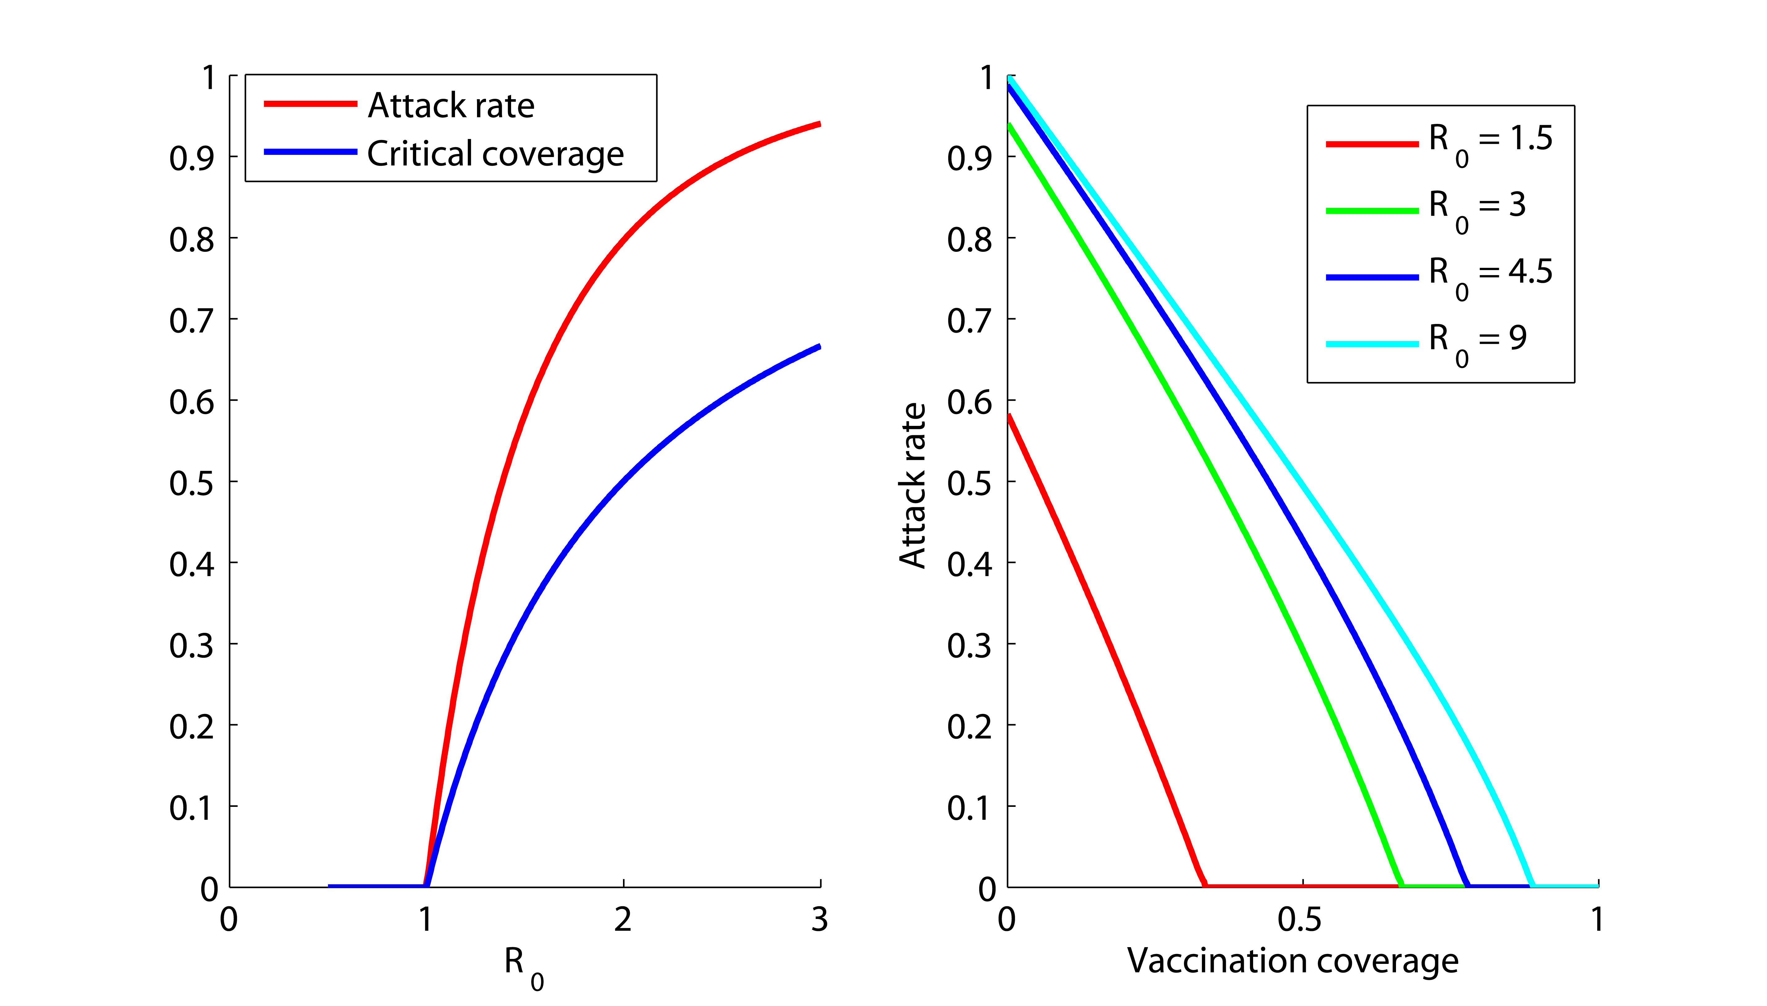
What can we use the models for?
R₀ and T_{g} can be estimated from epidemic data (e.g. daily number of reported cases) during the early phase.
Can we use the model to predict the number of infections?
What would the infection attack rate be if the critical vaccination coverage is not reached?
overshoot

Slide 38
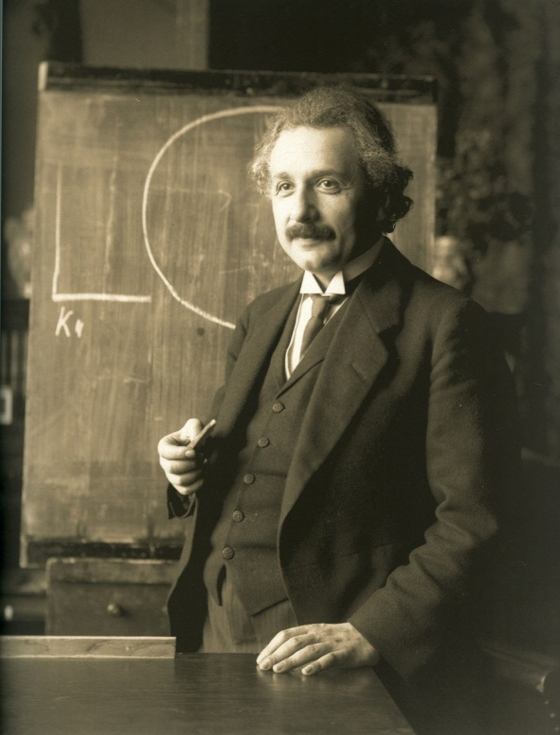
Building more complexities into the model
Stochasticity (“chance effects”)
More detailed natural history , e.g. asymptomatic infections
Age structure and multiple populations
Aging, birth, deaths, immigration, emigration
Seasonality and other time-dependent forcing
Individual-based model instead of compartmental model
“Everything should be made as simple as possible, but not simpler.”
Albert Einstein
Nobel Prize in Physics 1921
Models should be:
Complex enough to provide robust answers
Simple enough to avoid unnecessary details

Slide 39
More detailed natural history
Latent period – the period of time during which the infected individual is not yet infectious (e.g. the latent period is 14 days on average for smallpox)
4 compartments: “Susceptible”, “Exposed”, “Infectious”, and “Recovered”
More than one possible pathway, e.g. an infected individual develops symptoms only with probability p
S
E
I
R
p
I
S
E
R
1− p
A

Slide 40
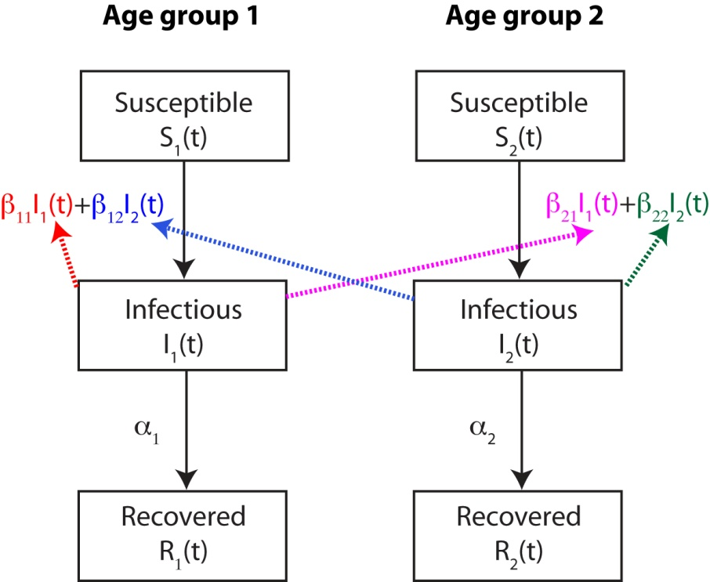
Age structure
Age-specific transmissibility and natural history.
β_{ij}: transmission rate from age group j to age group i. If there are n age groups, then there are n² β_{ij}’s.

Slide 41
Multiple populations
While the assumption of homogenous mixing may be reasonable for within-population epidemic dynamics, it is obviously not valid when considering epidemic dynamics among different populations that are weakly interacting (e.g. Hong Kong and Beijing)
Common models to simulate epidemic dynamics among populations (linked by human travel): meta-population models, gravity model
S₁
I₁
R₁
Traveling
S₂
I₂
R₂
Population 1
Population 2

Slide 42
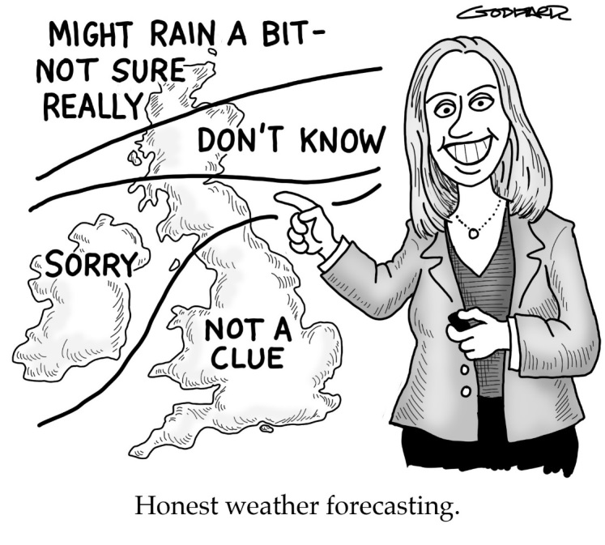
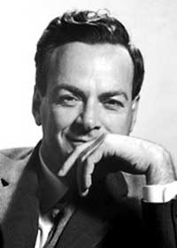
Uncertainty
Perspective of policy makers and the public
Intuitive
Accurate
Concise
Certain
Perspective of modellers
Models are approximations
and simplifications
Model accuracy and precision
depend on the quality and quantity
of data
“In physics the truth is rarely perfectly clear, and that is certainly universally the case in human affairs. Hence, what is not surrounded by uncertainty cannot be the truth.”
"For a successful technology, reality must take precedence over public relations, for Nature cannot be fooled."
Richard Feynamn
Nobel Prize in Physics 1965

Slide 43
Sources of uncertainty
Dynamic uncertainty
Nonlinearity and stochasticity
Observation uncertainty
We cannot observe the state of the system perfectly, e.g. how many people are infected, susceptible, immune.
Parametric uncertainty
Model parameters often need to be inferred from epidemiologic and clinical data
Structural (model) uncertainty
Model structures are typically highly subjective. Not everyone would agree on the same model structure and assumptions
Scenario uncertainty
Future events that may happen and have substantial impact on epidemic dynamics, e.g. availability of vaccines, behavioral changes

Slide 44

Stochasticity
Deterministic system: Outcome is the same every time you run it (e.g. classical mechanics such as dropping a ball)
Stochastic system: Outcome is not necessarily the same every time you run it be cause of randomness (e.g. flipping a coin)
We cannot predict the exact outcome of stochastic systems. But we can describe the probabilistic behavior (e.g. mean, standard deviation, probability density functions) of the possible outcomes.

Slide 45
Stochasticity
Stochastic effects are important when the number of infections is low:
outbreak establishment and tail of epidemics
persistence of endemic diseases
disease elimination
spatial spread
An outbreak can go extinct without exponential growth even when if R₀ > 1 because of stochasticity in disease transmission
The probability of extinction depends both on the mean number of secondary cases per case (R₀) and the variance in the number of secondary cases.
In contrast, in a deterministic model, there will always be an epidemic if R₀ > 1, which is unrealistic.

Slide 46
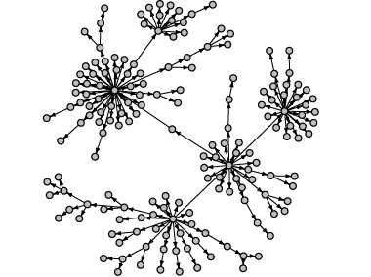
Stochasticity in transmission
The number of secondary infections per index case vary substantially among infected cases (i.e. the offspring distribution has substantial variance):
Frequency and type of contacts may be highly variable, e.g. age
Infectiousness may be highly variable among infected people, e.g. children have longer period of viral shedding for influenza
Susceptibility may be highly variable among people, e.g. older adults may be less susceptible because of previous exposure
Environmental settings may be very important for transmission, e.g. Amoy Garden for SARS transmission in Hong Kong
Infection tree for SARS in Sinagore (from contact tracing)

Slide 47
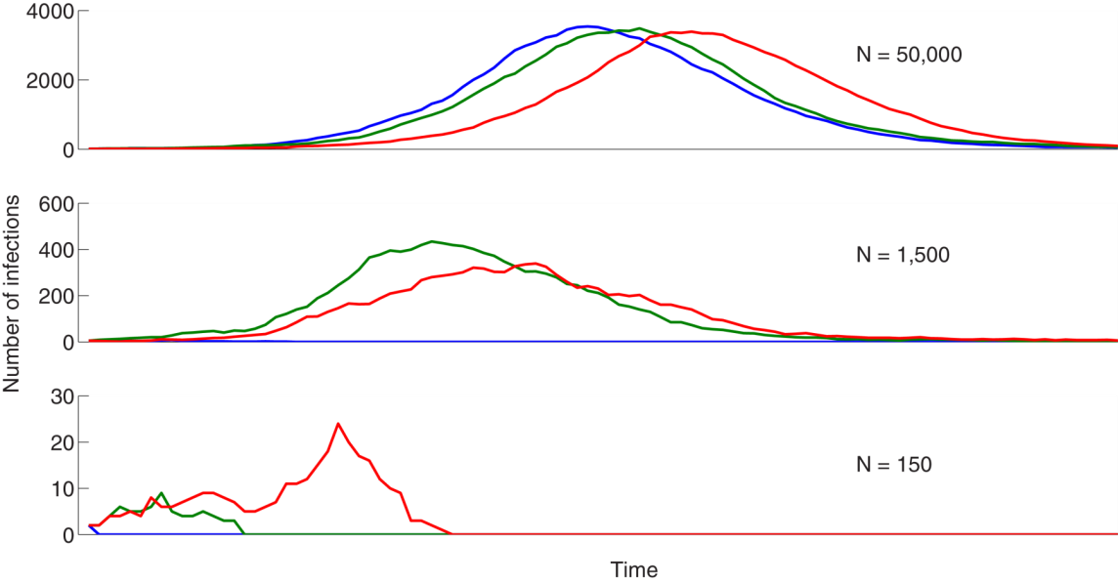
Stochastic vs deterministic dynamics
A stochastic system consists of a population and event types.
Simulation comprises multiple realizations of the stochastic system – all of which differ
Simple basic idea – in any time interval there is a certain probability of each type of event occurring (e.g. birth/death/infection/recovery).
Deterministic models approximate by saying that in any time interval, the mean number of events of any particular type occur.
Three realizations from a stochastic SIR model at three population sizes with R₀=1.5.

Slide 48
Stochastic vs deterministic models
S
I
R
Boxes: compartment or states
Arrows: rates for deterministic models; hazards for stochastic models
In the stochastic model, the probability of an individual going from origin to destination between time t and t+Δt is hazard × Δt.
What is the difference between rate and hazard?
The number of individuals going from origin to destination between time t and t+Δt is:
Deterministic models
(number of individuals in the origin state at time t) × rate × Δt
Stochastic models
Binomial random variable with
n = number of individuals in the origin state at time t
p = hazard × Δt

Slide 49
Stochastic vs deterministic models
Deterministic model
Stochastic model

Slide 50

“Mathematical models formulation in the biomedical sciences more often acts to tell you what to do not know rather than providing a precise predictive tool.”
-- Sir Roy Anderson FRS
Uncertainties in model outputs could be utilized as a guide for improving data collection and refining evidence synthesis.

Slide 51
Readings
Dobson A. (2014) Epidemiology. Mathematical models for emerging disease. Science.
Garnett GP, Cousens S, Hallett TB, Steketee R, Walker N. (2011) Mathematical models in the evaluation of health programmes. Lancet.
Grassly NC, Fraser C. (2008) Mathematical models of infectious disease transmission. Nat Rev Microbiol.
Heesterbeek H et al. (2015) Modeling infectious disease dynamics in the complex landscape of global health. Science.
Lofgren ET et al. (2014) Opinion: Mathematical models: a key tool for outbreak response. Proc Natl Acad Sci U S A. 2014
May RM (2004) Uses and abuses of mathematics in biology. Science 303: 790-793.

